Slide 1

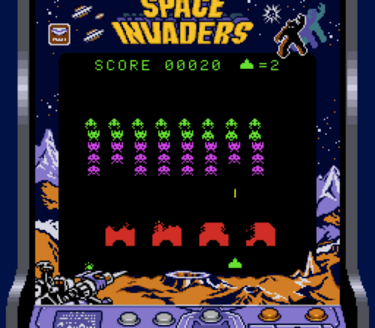
10. Invaders
Let’s Learn
Aj. Andrew Davison, CoE, PSU Hat Yai Campus
E-mail: ad@fivedots.coe.psu.ac.th

Slide 2
Outline
The Invaders Game
invaders.py Classes
The main Program
Support Functions used in main
The Player
An Alien
Animated Sprites

Slide 3
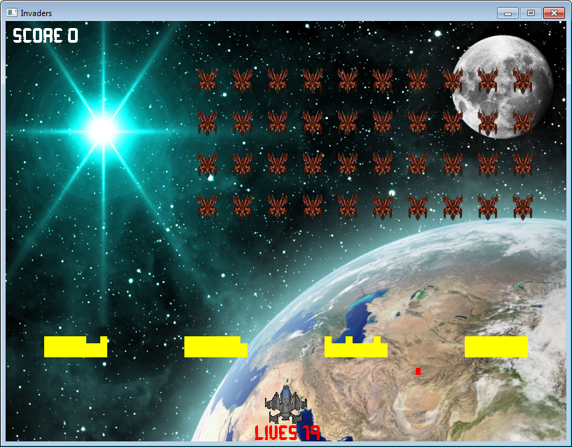
1. The Invaders Game
score text
40 Aliens
(4 x 10)
4 Walls, made
of 3 x 9 Blocks
each
2 kinds of
Ammo
lives text
Player

Slide 4
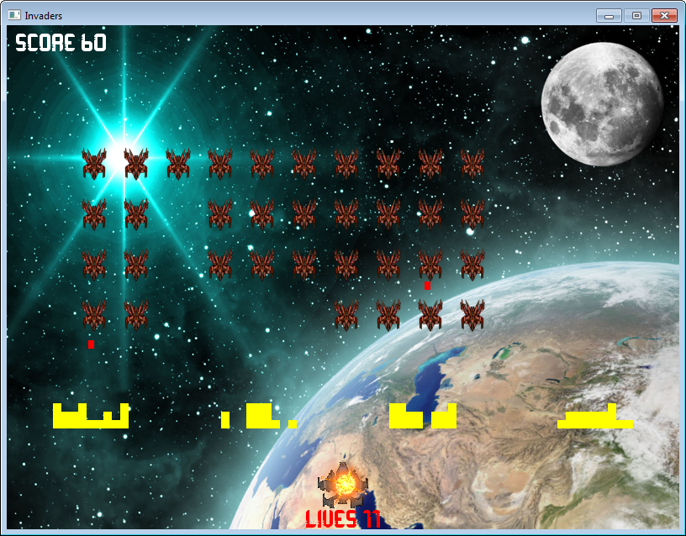
aliens move
together
left and right
and down
aliens die
when hit by
player ammo
blocks in a wall
disappear
when hit by
ammo
animated
explosion for
the player; no.
of lives goes
down
player can only
move left or right
along bottom
alien ammo
is red
player ammo
is blue and
longer
Ammo moves vertically – down
for alien ammo, up for player
There are 2 kinds of animated
explosions for player and aliens

Slide 5
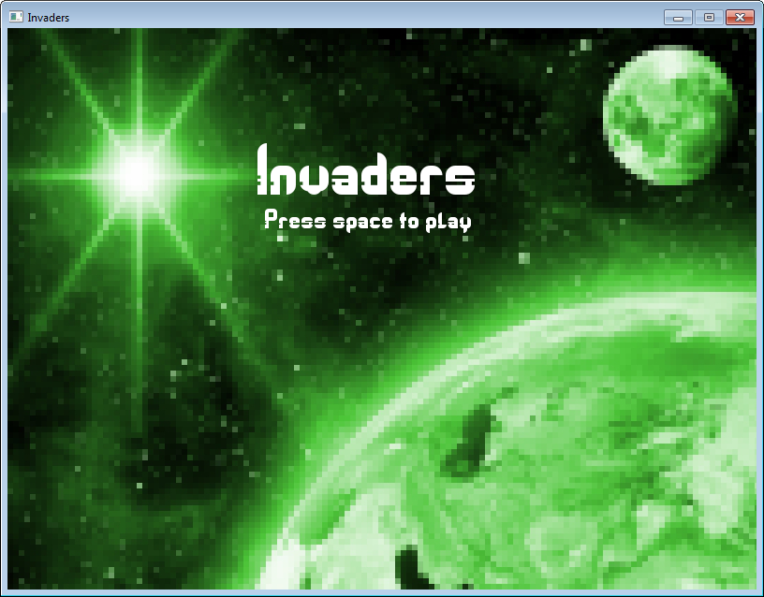
I use my
own font to
write the text.
A "start screen" appears at the start.
The game begins when the uses presses
the space bar.

Slide 6
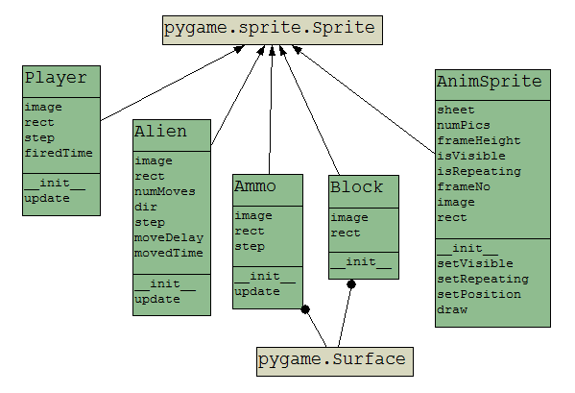
2. invaders.py Classes
inherits
variables
functions
uses

Slide 7
Objects made by Classes
1 player object from Player
40 alien objects from Alien
Many ammo objects created during the game from Ammo
red ammo for the aliens
blue ammo for the player
4 walls are created, made out of 3 x 9 Block objects each (wall is not a class)
2 animations are made from AnimSprite
1 for alien explosions; 1 for player explosions

Slide 8
Support Functions used in main
def createWall(rows, columns, sep):
: # build 1 wall of rows x columns blocks
def createAliens(rows, columns, sep):
: # create rows x columns aliens
def playerShoot():
: # let player shoot ammo only once every 500 ms
def alienShoot():
: # randomly choose an alien to shoot ammo
def checkCollisions():
: # check for 4 types of collision
def isGameOver():
: # has player won or lost?
"time-constraint"
a common
game requirement

Slide 9
3. The main Program
My own font instead
of using one in
Windows
pygame.init()
screen = pygame.display.set_mode([800, 600])
pygame.display.set_caption('Invaders')
scrWidth, scrHeight = screen.get_size()
# game fonts
pygame.font.init()
gameFont = pygame.font.Font('Orbitracer.ttf', 28)
splashFont = pygame.font.Font('Orbitracer.ttf', 72)
# load game images
startIm = pygame.image.load('startScreen.jpg').convert()
background = pygame.image.load('background.jpg').convert()
# load game sounds
pygame.mixer.music.load('arpanauts.ogg')
pygame.mixer.music.play(-1) # forever
pygame.mixer.music.set_volume(0.7)
bullet_fx = pygame.mixer.Sound('fire.wav')
explosion_fx = pygame.mixer.Sound('explode.wav')
boom_fx = pygame.mixer.Sound('boom.wav')
Two images are
loaded – one for
the start screen,
and one for the
background
of the game.
Music and three
sound effects

Slide 10
# game vars
showStartScreen = True
gameOver = False
finalMsg = ""
# player vars
playerDir = 0
canFire = False
score = 0
numLives = 20
# create sprite groups
aliens = pygame.sprite.Group()
bullets = pygame.sprite.Group() # ammo shot by the player
missiles = pygame.sprite.Group() # ammo shot by the aliens
walls = pygame.sprite.Group() # for all blocks of all 4 walls
sprites = pygame.sprite.Group() # every object is in here;
# makes updating and drawing easy
game state booleans for
showing start screen and
game playing

Slide 11
# create player, walls, and alien sprites
player = Player()
playerGroup = pygame.sprite.Group(player)
sprites.add(player)
for spacing in range(4): # create 4 walls
createWall(3, 9, spacing)
# a wall is 3 x 9 bricks (rows x cols)
createAliens(4, 10, ALIEN_SEP)
# create grid of 4 x 10 aliens (rows x cols)
# create explosion sprites
playerExplo = AnimSprite('exploSheet.png', 9)
alienExplo = AnimSprite('alienExploSheet.png', 10)

Slide 12
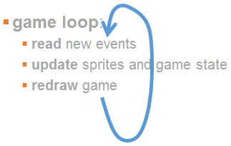
clock = pygame.time.Clock()
running = True
while running:
clock.tick(30)
# handle events
for event in pygame.event.get():
if event.type == QUIT:
running = False
if event.type == KEYDOWN:
if event.key == K_ESCAPE:
running = False
elif event.key == K_LEFT:
playerDir = -1
elif event.key == K_RIGHT:
playerDir = 1
elif event.key == K_SPACE:
if showStartScreen:
showStartScreen = False
else:
canFire = True
elif event.type == KEYUP:
if event.key == K_LEFT or event.key == K_RIGHT:
playerDir = 0
Repeating key action
technique: KEYDOWN
and KEYUP
game state change,
from start screen
to playing game

Slide 13
# update game
if not showStartScreen and not gameOver:
for i in sprites:
i.update()
alienShoot()
if canFire:
playerShoot()
checkCollisions()
gameOver = isGameOver()
game is updated only if not
showing start screen and
the game is not over
support functions hide
confusing detail; makes the
updating easier to understand

Slide 14
# redraw game
if showStartScreen:
screen.blit(startIm, [0, 0])
screen.blit(splashFont.render(
"Invaders", 1, WHITE),(265, 120))
screen.blit(gameFont.render(
"Press space to play", 1, WHITE),(274, 191))
else:
screen.blit(background, [0, 0])
sprites.draw(screen)
playerExplo.draw(screen)
alienExplo.draw(screen)
screen.blit(gameFont.render(
"SCORE " + str(score), 1, WHITE), (10, 8))
screen.blit(gameFont.render(
"LIVES " + str(numLives + 1), 1, RED), (355, 575))
if gameOver:
screen.blit(gameFont.render(finalMsg, 1, RED), (200, 15))
pygame.display.update()
pygame.quit()
1
2
redrawing has two parts:
one for start screen, one for
game play

Slide 15
More Game States
There are three boolean variables used:
running: is the game loop running?
gameOver: is the user playing a game?
showStartScreen: is the start screen being shown?
running == True
lives == 0;
player loses
showStartScreen
== True
gameOver
== False
user types
space bar
all aliens dead;
player wins
user playing
the game
user presses close box,
or ESC to stop game running

Slide 16
4. Support Functions used in main
def createWall(rows, columns, sep):
: # build 1 wall of rows x columns blocks
def createAliens(rows, columns, sep):
: # create rows x columns aliens
def playerShoot():
: # let player shoot ammo only once every 500 ms
def alienShoot():
: # randomly choose an alien to shoot ammo
def checkCollisions():
: # check for 4 types of collision
def isGameOver():
: # has player won or lost?
"time-constraint"
a common
game requirement

Slide 17
The createWall() Function
createAliens() is very similar
def createWall(rows, columns, sep):
for r in range(rows):
for c in range(columns):
block = Block()
block.rect.x = (55 + (200 * sep)) +
(c * block.rect.width)
block.rect.y = 450 + (r * block.rect.height)
walls.add(block)
sprites.add(block)
Lots of block objects, stored
in walls and sprites groups

Slide 18
The alienShoot() function
Randomly choose an alien (using the random module), and create a red Ammo object
def alienShoot():
if len(aliens):
if random.random() <= 0.05:
shooter = random.choice(
[ alien for alien in aliens])
# randomly choose from aliens group as a list
x, y = shooter.rect.midbottom
x -= MISSILE_SIZE[0]
y += MISSILE_SIZE[1]
missile = Ammo(RED, MISSILE_SIZE, x, y, 10)
# missiles move down
missiles.add(missile)
sprites.add(missile)

Slide 19
The PlayerShoot() Function
Time-constraint: the player can only shoot once every 500 ms
use the Pygame ms time function, get_ticks()
record the last shoot time in player.firedTime
def playerShoot():
global canFire
currTime = pygame.time.get_ticks()
if (currTime - player.firedTime) > 500: #shoot only after 500 ms
x, y = player.rect.midtop
x -= BULLET_SIZE[0]
y -= BULLET_SIZE[1]
bullet = Ammo(BLUE, BULLET_SIZE, x, y, -26) #bullets move up
bullets.add(bullet)
sprites.add(bullet)
player.firedTime = currTime
bullet_fx.play()
canFire = False

Slide 20
The checkCollisions() Function
The game has four kinds of collision:
when a (player) bullet hits a block in a wall
both the bullet and block disappear
when an (alien) missile hits a block in a wall
both the missile and block disappear
when a (player) bullet hits an alien
both the bullet and alien disappear
when an (alien) missile hits the player
the missile disappears, but the player only loses a life

Slide 21
def checkCollisions():
global score, numLives
pygame.sprite.groupcollide(bullets, walls, True, True)
# disappear/kill arguments
# a player bullet hits a walls brick
pygame.sprite.groupcollide(missiles, walls, True, True)
# a missile hits a walls brick
for z in pygame.sprite.groupcollide(bullets, aliens, True, True):
# a player bullet hits an alien
alienExplo.setPosition(z.rect.center)
alienExplo.setVisible(True)
boom_fx.play()
score += 10
if pygame.sprite.groupcollide(playerGroup, missiles, False, True):
# a missile hits the player
playerExplo.setPosition(player.rect.center)
playerExplo.setVisible(True)
explosion_fx.play()
numLives -= 1
Animation object positioned and made visible. Sound effect is played.

Slide 22
The isGameOver() Function
The game can end in two ways – the player can lose, or the player can win.
def isGameOver():
global finalMsg
if numLives == 0:
finalMsg = "The war is lost! You scored: " +
str(score)
return True
elif len(aliens) == 0:
finalMsg = "You win! You scored: " + str(score)
return True
else:
return False

Slide 23
5. The Player
The player can move left and right depending on the value in the playerDir global.
The player cannot move off the screen, so its x posiition must stay between 0 and scrWidth

Slide 24
class Player(pygame.sprite.Sprite):
def __init__(self):
super().__init__()
self.image =
pygame.image.load("player.png").convert_alpha()
self.rect = self.image.get_rect()
self.rect.x = (scrWidth/2) - (self.rect.width/2)
self.rect.y = 520
self.step = 7 # step is 7 units
self.firedTime = 0 # when player last fired a shot
def update(self):
self.rect.x += playerDir * self.step
if self.rect.x < 0: # stay visible
self.rect.x = 0
elif self.rect.x > (scrWidth - self.rect.width):
self.rect.x = scrWidth - self.rect.width

Slide 25
6. An Alien
12 steps
3 types of movement
makes update()
complicated
12 steps
1 step
An alien moves to the left and right, and downwards
each step across ≈ image width units
each step down = ALIEN_STEP units
an alien moves left 12 times, then right 12 times
an alien moves down only 4 times
a step is time-constrained, so it occurs once every moveDelay ms
AND moveDelay gets smaller as the game continues

Slide 26
class Alien(pygame.sprite.Sprite):
def __init__(self):
super().__init__()
self.image = pygame.image.load("alien.png").convert_alpha()
self.rect = self.image.get_rect()
self.numMoves = [0, 0] # in x- and y- directions
self.dir = 1 # or -1 in x-direction
self.step = self.image.get_width() - 7 # in x-direction
self.moveDelay = 700 # time delay between moves (in ms)
self.movedTime = 0 # when alien last moved
def update(self):
currTime = pygame.time.get_ticks()
if (currTime - self.movedTime) > self.moveDelay:
if self.numMoves[0] < 12:
self.rect.x += self.dir * self.step # move horizontally
self.numMoves[0] += 1
else:
if self.numMoves[1] < 4:
self.rect.y += ALIEN_SEP # move down
self.numMoves[1] += 1
self.dir *= -1 # change x- direction
self.numMoves[0] = 0 # reset num of x moves
self.moveDelay -= 20 # reduce delay between moves
self.movedTime = currTime # store move time
used to code
3 kinds of move
time-constraint

Slide 27
7. Animated Sprites
The coding trick is to load several pictures into a sprite which represent "movie frames".
The sprite's displayed picture is changed quickly between the frames to make it look animated.
9 frames (pictures with
transparent backgrounds)
stored in exploSheet.png

Slide 28
Creating an Animated Sprite
See the code in main:
# create explosion sprites
playerExplo = AnimSprite('exploSheet.png', 9)
alienExplo = AnimSprite('alienExploSheet.png', 10)
name of the
image file
how many frames
are in the image

Slide 29
Initializing an AnimSprite Object
(0,y)
h
w
class AnimSprite(pygame.sprite.Sprite):
def __init__(self, fnm, numPics):
# assume that fnm is a column of numPics pics
super().__init__()
self.sheet = pygame.image.load(fnm).convert_alpha()
self.numPics = numPics
self.frameHeight = self.sheet.get_height()/numPics
self.isVisible = False
self.isRepeating = False
self.frameNo = 0
self.image = self.sheet.subsurface(0,
self.frameNo * self.frameHeight,
self.sheet.get_width(),
self.frameHeight)
self.rect = self.image.get_rect()
x, y, width, height

Slide 30
Drawing the Next Frame
(0,y1)
h
w
def draw(self, screen):
if self.isVisible:
screen.blit(self.image, [self.rect.x, self.rect.y])
self.frameNo = (self.frameNo + 1) % self.numPics
self.image = self.sheet.subsurface(0,
self.frameNo * self.frameHeight,
self.sheet.get_width(),
self.frameHeight)
if self.frameNo == 0 and not self.isRepeating:
self.isVisible = False
x, y, width, height

Slide 31
Other Animation Functions
def setVisible(self, isVisible):
self.isVisible = isVisible
def setRepeating(self, isRepeating):
self.isRepeating = isRepeating
def setPosition(self, pos):
self.rect.center = pos
this will make the
animation loop
around; not used in
this game

